Slide 1
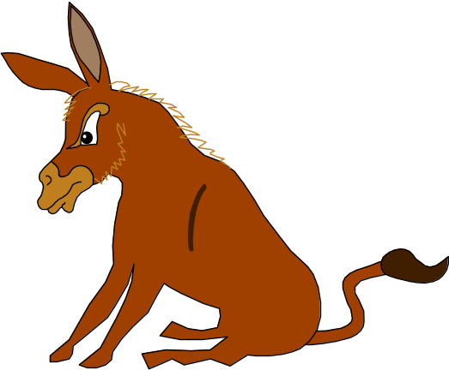
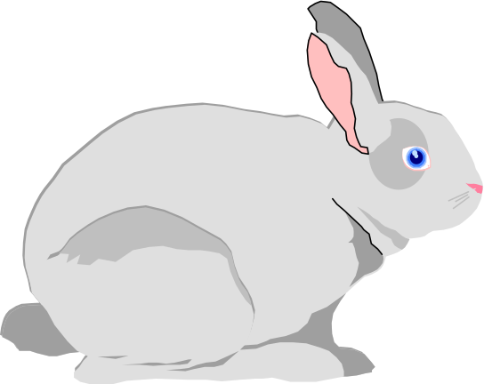
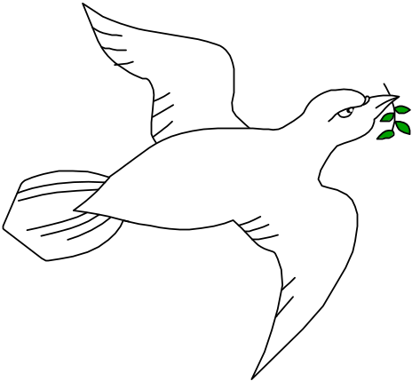
Genetic Algorithm
Survival of the fittest basis
Dr. M. S. Uddin, CSE Dept, JU

Slide 2
Genetic Algorithm
Outline:
Introduction to GA
Main steps of GA
Genetic Operators
Examples
Summary
Dr. M. S. Uddin, CSE Dept, JU

Slide 3
GA Introduction
The Genetic algorithm, developed by John Holland [1962] is an optimization (search) technique that operates over a population of encoded candidate solutions to solve a given problem.
GA belongs to a class of stochastic search method based on biological evolution (first observed by Charles Darwin). They represent a highly parallel adaptive search process.
In natural (biological) evolution, species search for increasingly beneficial adaptations for survival within their complex environments.
The search takes place in the species’ chromosomes where changes, and their effects, are graded by the survival and reproduction of the species. This is the basis for survival of the fittest.
Central to the idea of GA is a population where individuals in the population represent possible solutions. An individual is called chromosome, in analogy with the genetic chromosome.
The chromosome is usually represented by a bit string consisting of 0’s and 1’s.
New population is generated from old population with two basic genetic operators namely cross-over and mutation.
Dr. M. S. Uddin, CSE Dept, JU

Slide 4
GA Introduction
The Genetic algorithm, developed by John Holland [1962] is an optimization (search) technique that operates over a population of encoded candidate solutions to solve a given problem.
GA belongs to a class of stochastic search method based on biological evolution (first observed by Charles Darwin). They represent a highly parallel adaptive search process.
In natural (biological) evolution, species search for increasingly beneficial adaptations for survival within their complex environments.
The search takes place in the species’ chromosomes where changes, and their effects, are graded by the survival and reproduction of the species. This is the basis for survival of the fittest.
Dr. M. S. Uddin, CSE Dept, JU

Slide 5
GA Introduction
Central to the idea of GA is a population where individuals in the population represent possible solutions. An individual is called chromosome, in analogy with the genetic chromosome.
The chromosome is usually represented by a bit string consisting of 0’s and 1’s.
New population is generated from old population with two basic genetic operators namely cross-over and mutation.
Dr. M. S. Uddin, CSE Dept, JU

Slide 6
Main Steps of GA
A GA represents an iterative process. Each iteration is called a generation. The entire set of generations is called a run. At the end of a run, we expect to find one or more highly fit chromosomes.
The GA consists of three fundamental steps, excluding the initialization. These are: Evaluation, Selection, and Recombination
Initialization: initial creation of the population
Evaluation: fitness of the population is calculated.
Selection:a subset of the the population is selected based upon a predefined selection criterion.
Recombination: selected subpopulation is recombined to result a new population.
Initialization
Evaluation
Selection
Recombination
Flow chart of GA
Dr. M. S. Uddin, CSE Dept, JU

Slide 7
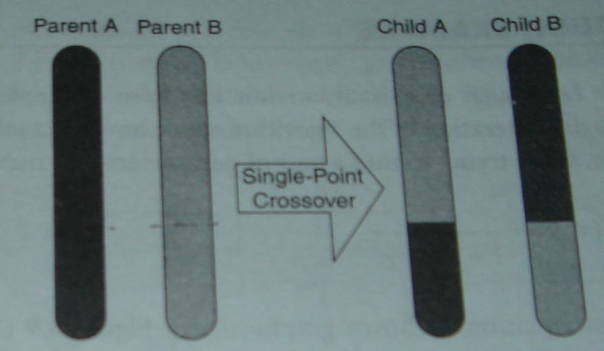
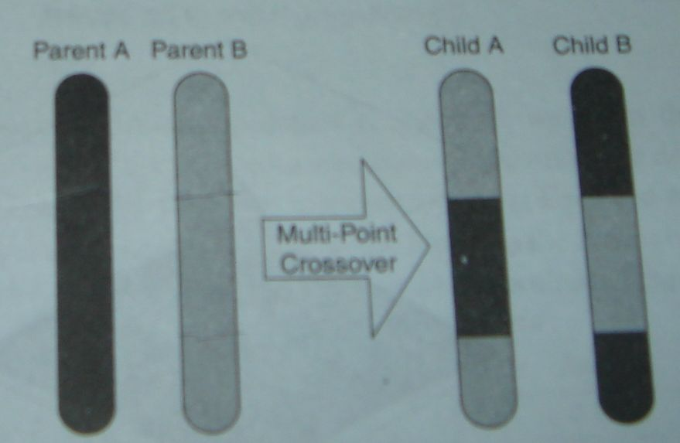
Genetic Operator: Cross-over
Cross-over: takes two chromosomes (parents), separates them at a random site (in both chromosomes) and then swaps the tails of the two, resulting in two new chromosomes (children).
Cross over operator randomly chooses a crossover point where two parent chromosomes ‘break’ and then exchanges the chromosome parts after that point.
A value of 0.7 for the cross-over probability generally produces good results.
Dr. M. S. Uddin, CSE Dept, JU

Slide 8
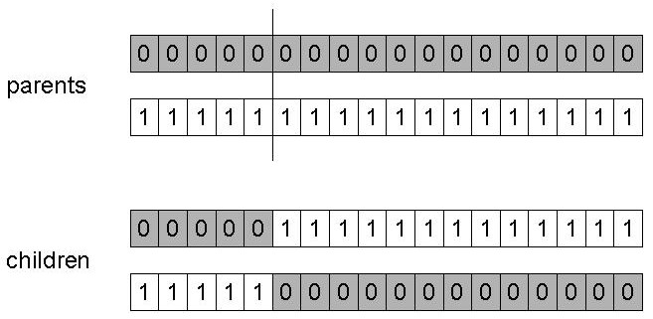
Genetic Operator: Cross-over
Single-point cross-over
Choose a random point on the two parents
Split parents at this crossover point
Create children by exchanging tails
Dr. M. S. Uddin, CSE Dept, JU

Slide 9
Genetic Operator: Mutation
Mutation, which is rare in nature represents a change in the gene. It may lead to a significant improvement in fitness, but more often has rather harmful results.
The mutation operator introduces a random change into a gene in the chromosome. It provides the ability to introduce new material into the chromosome.
The mutation probability is quite small in nature, in the range 0.0001 and 0.01.
Why use Mutation:
Mutation’s role is to provide a guarantee that the search algorithm is not trapped on a local optimum. The sequence of selection and crossover operations may stagnate at any homogeneous set of solutions. Under such conditions, all chromosomes are identical, and thus the average fitness of the population cannot be improved. The search algorithm is not able to proceed further. Mutation aids us in avoiding loss of genetic diversity.
Dr. M. S. Uddin, CSE Dept, JU

Slide 10
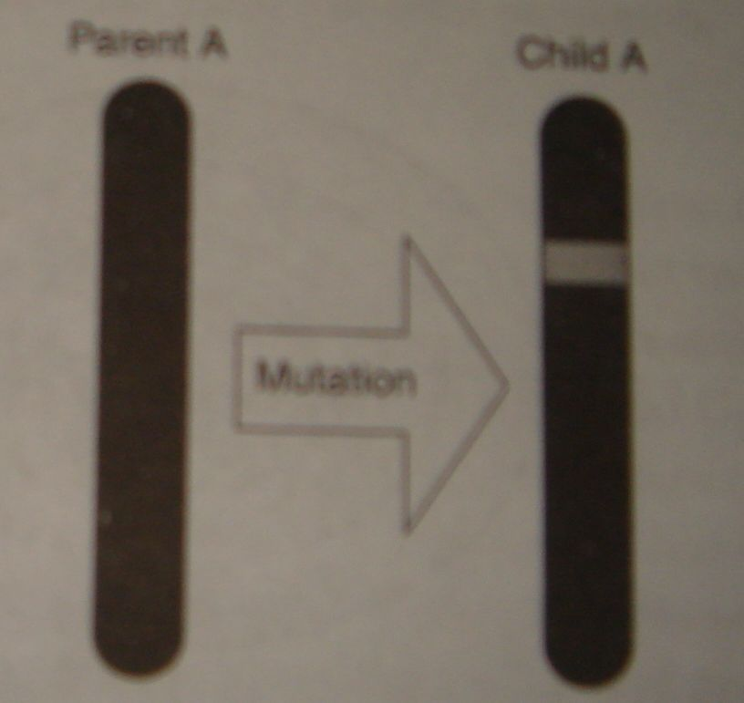
Genetic Operator: Mutation
Dr. M. S. Uddin, CSE Dept, JU

Slide 11
A Simple GA Example
f(x) = {MAX(x²): 0 <= x <= 32 }
Encode Solution: Just use 5 bits (1 or 0).
Generate initial population.
Evaluate each solution against objective.
A
0
1
1
0
1
B
1
1
0
0
0
C
0
1
0
0
0
D
1
0
0
1
1
Sol.
String
Fitness
% of Total
A
01101
169
14.4
B
11000
576
49.2
C
01000
64
5.5
D
10011
361
30.9
Dr. M. S. Uddin, CSE Dept, JU

Slide 12
A Simple GA Example (cont.)
Create next generation of solutions
  Probability of “being a parent” depends on the fitness.
Ways for parents to create next generation
  Crossover
    Cut and paste portions of one string to another.
  Mutation
    Randomly flip a bit.
  COMBINATION of all of the above.
Dr. M. S. Uddin, CSE Dept, JU

Slide 13
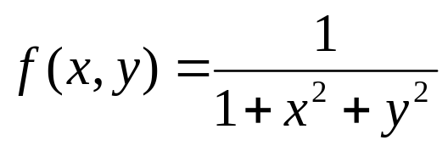
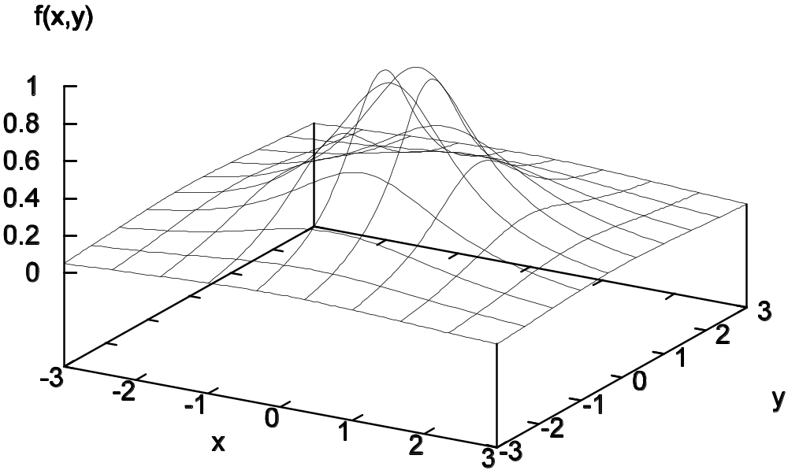
Another GA Example
Let try to find a pair of parameters that maximizes the following equation:
Dr. M. S. Uddin, CSE Dept, JU

Slide 14
GA Example (using cross-over only)
Initial population & fitness (Initialization and Evaluation):
x
y
fitness
C₀
-1.0
2.0
0.167
C₁
-2.0
3.0
0.007
Average fitness: 0.231
C₂
1.5
0.0
0.31
C₃
0.5
-1.0
0.44
Immediate next generation (using cross-over only) & fitness
Selection and Recombination):
x
y
fitness
C₀ (x_{C3} y_{C2})
0.5
0.0
0.800
Average fitness: 0.390
C₁(x_{C2} y_{C3})
1.5
-1.0
0.240
C₂(x_{C3} y_{C0})
0.5
2.0
0.190
C₃(x_{C0} y_{C3})
-1.0
-1.0
0.330
Dr. M. S. Uddin, CSE Dept, JU

Slide 15
GA Summary
GA is a heuristic method based on ‘ survival of the fittest.
Useful when search space is very large or too complex for analytic treatment.
GA has been employed in a wide variety of practical problems related to pattern recognition and image processing, computer-aided design, scheduling, economics and game theory, and so on. on.
Dr. M. S. Uddin, CSE Dept, JU

